Slide 1
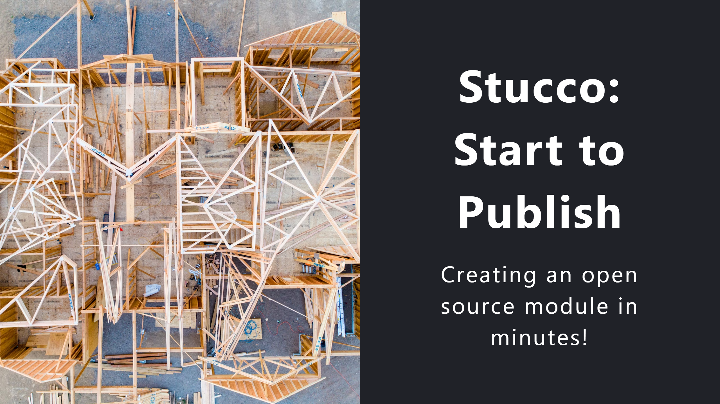
Notes:
For Demo I pre-logged into PSGallery & Github
Basic VM with the following configured
- Windows Terminal Preview
- Git
- VS Code w/ following Extensions
-- PowerShell Preview
-- markdownlint
-- Marp for VS Code

Slide 2


Slide 3
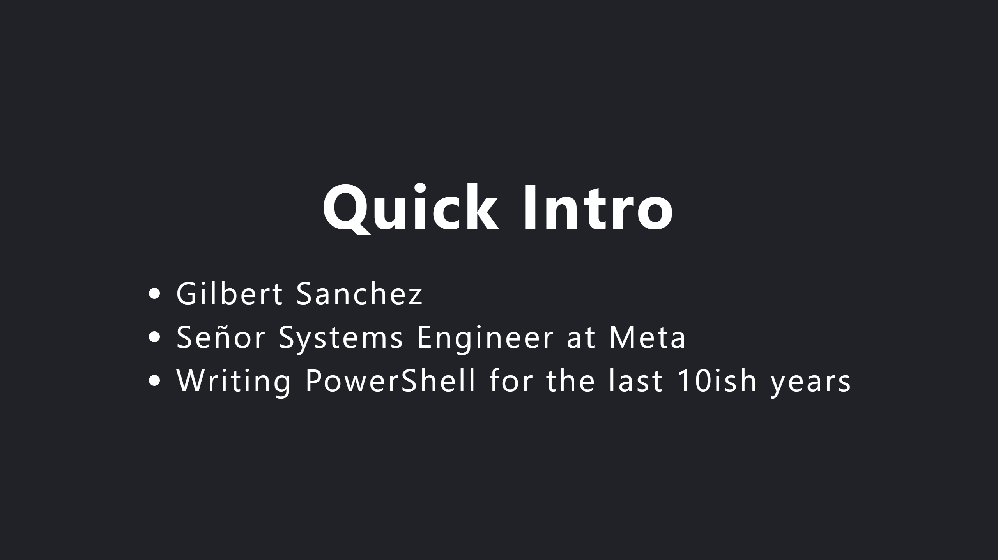

Slide 4
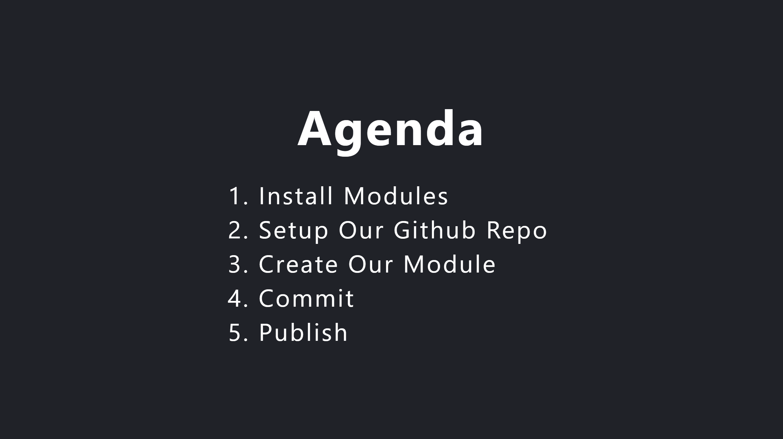

Slide 5
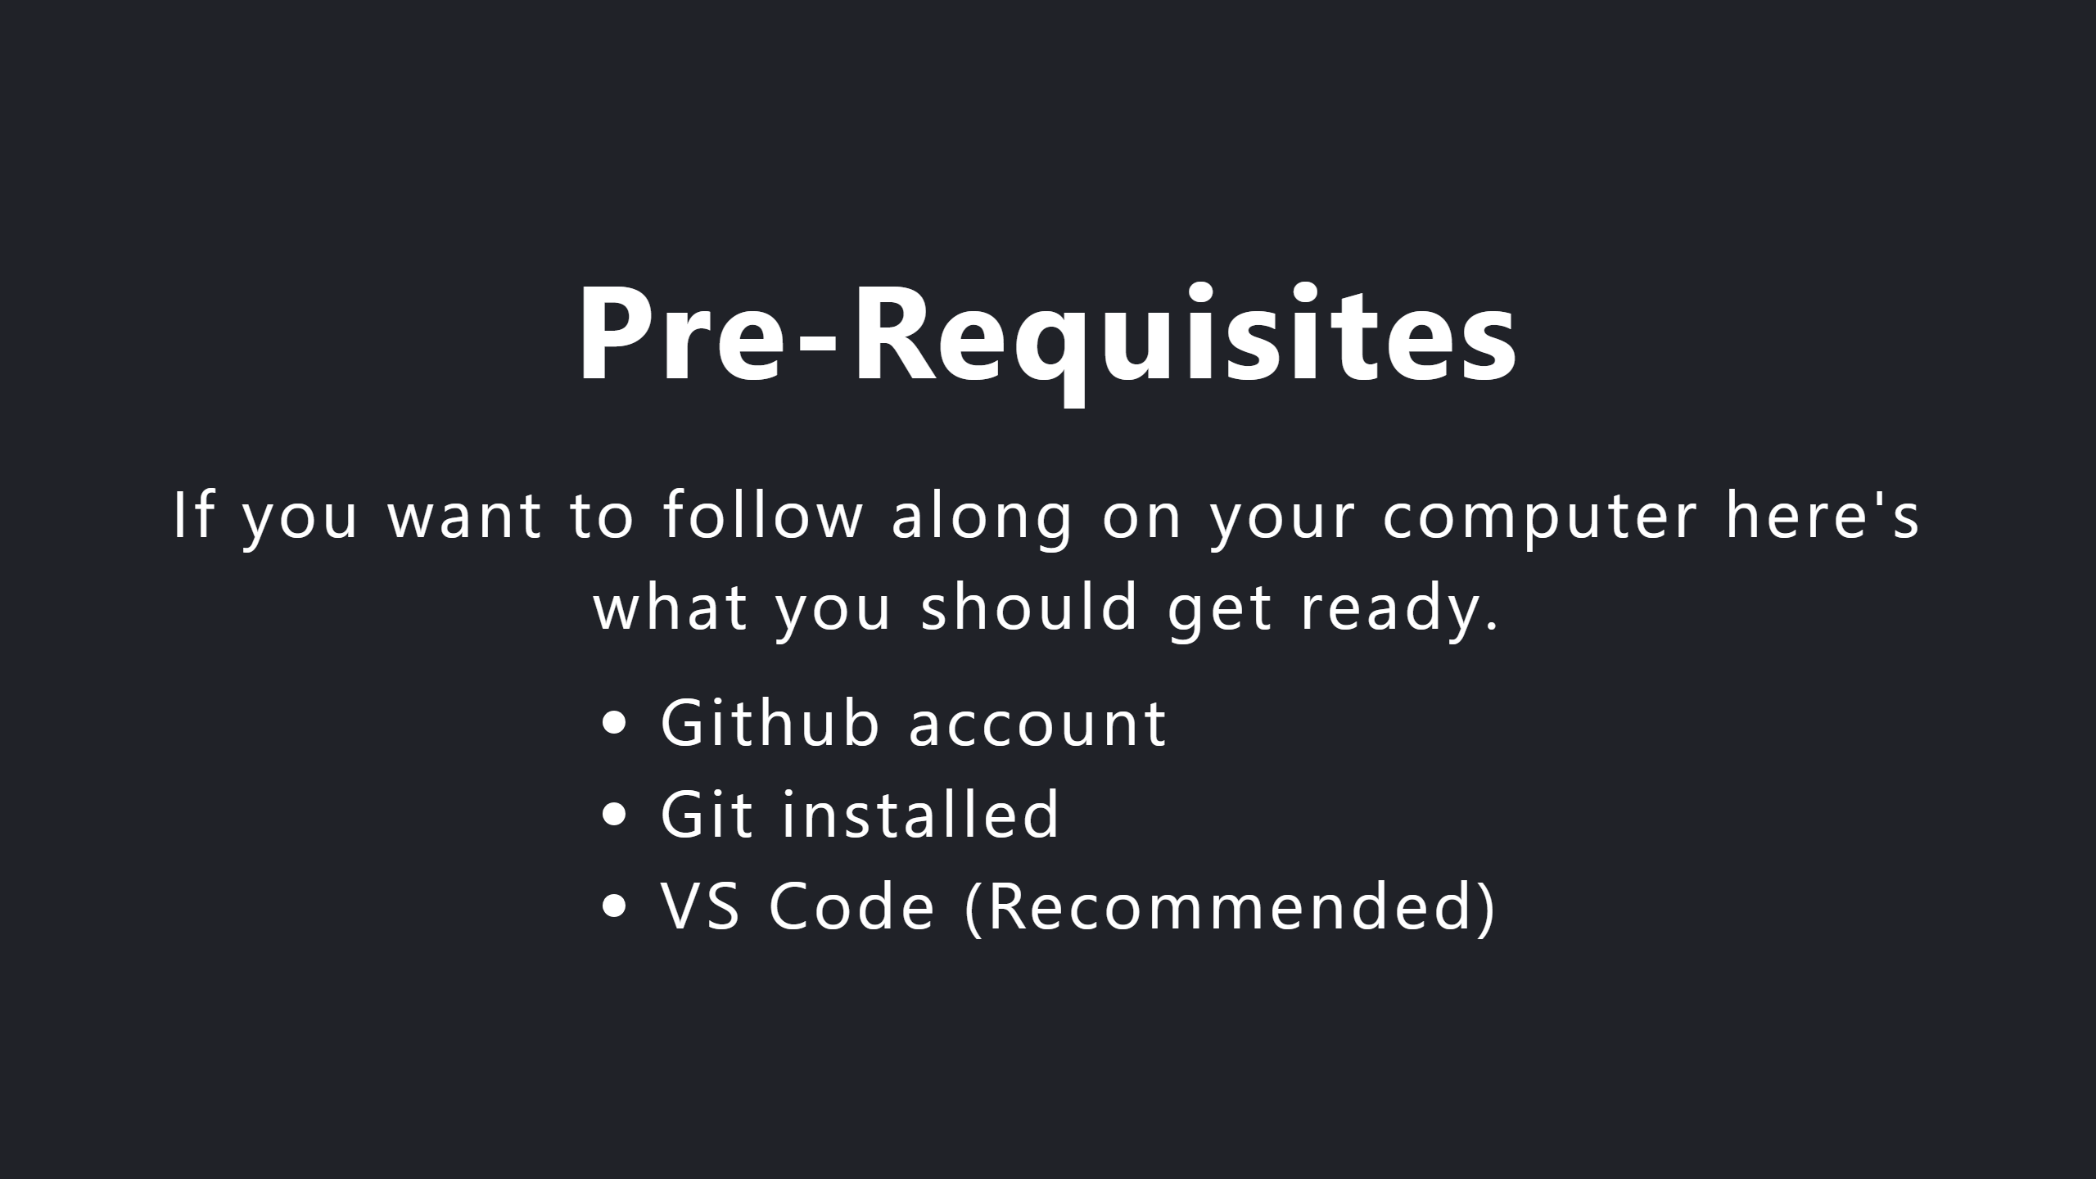

Slide 6
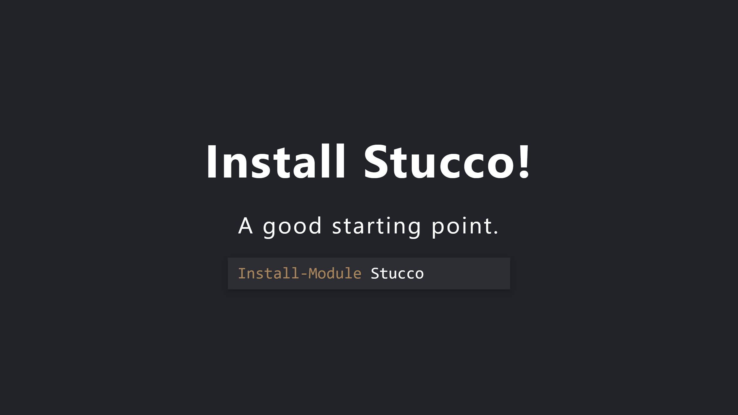
Notes:
Note that it installs it's pre-requisites.
Pester included (which you may need to )
Install-Module Pester -RequiredVersion 5.3.3 -SkipPublisherCheck

Slide 7
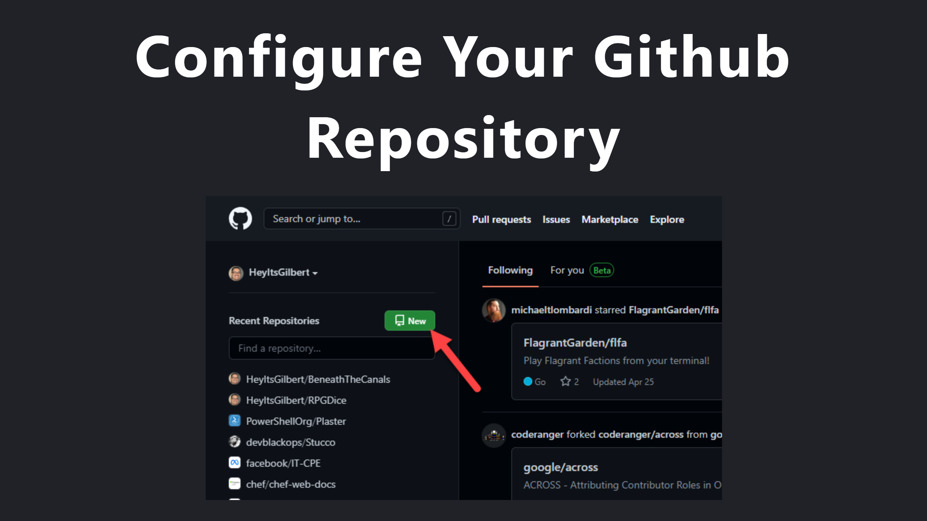

Slide 8
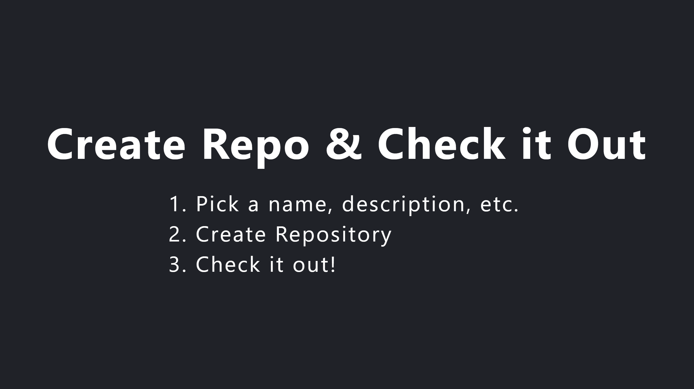
Notes:
A few options...
git clone ...
Github's tool

Slide 9
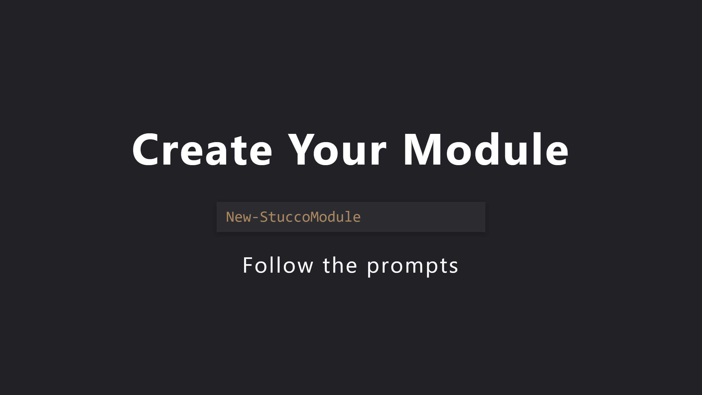

Slide 10
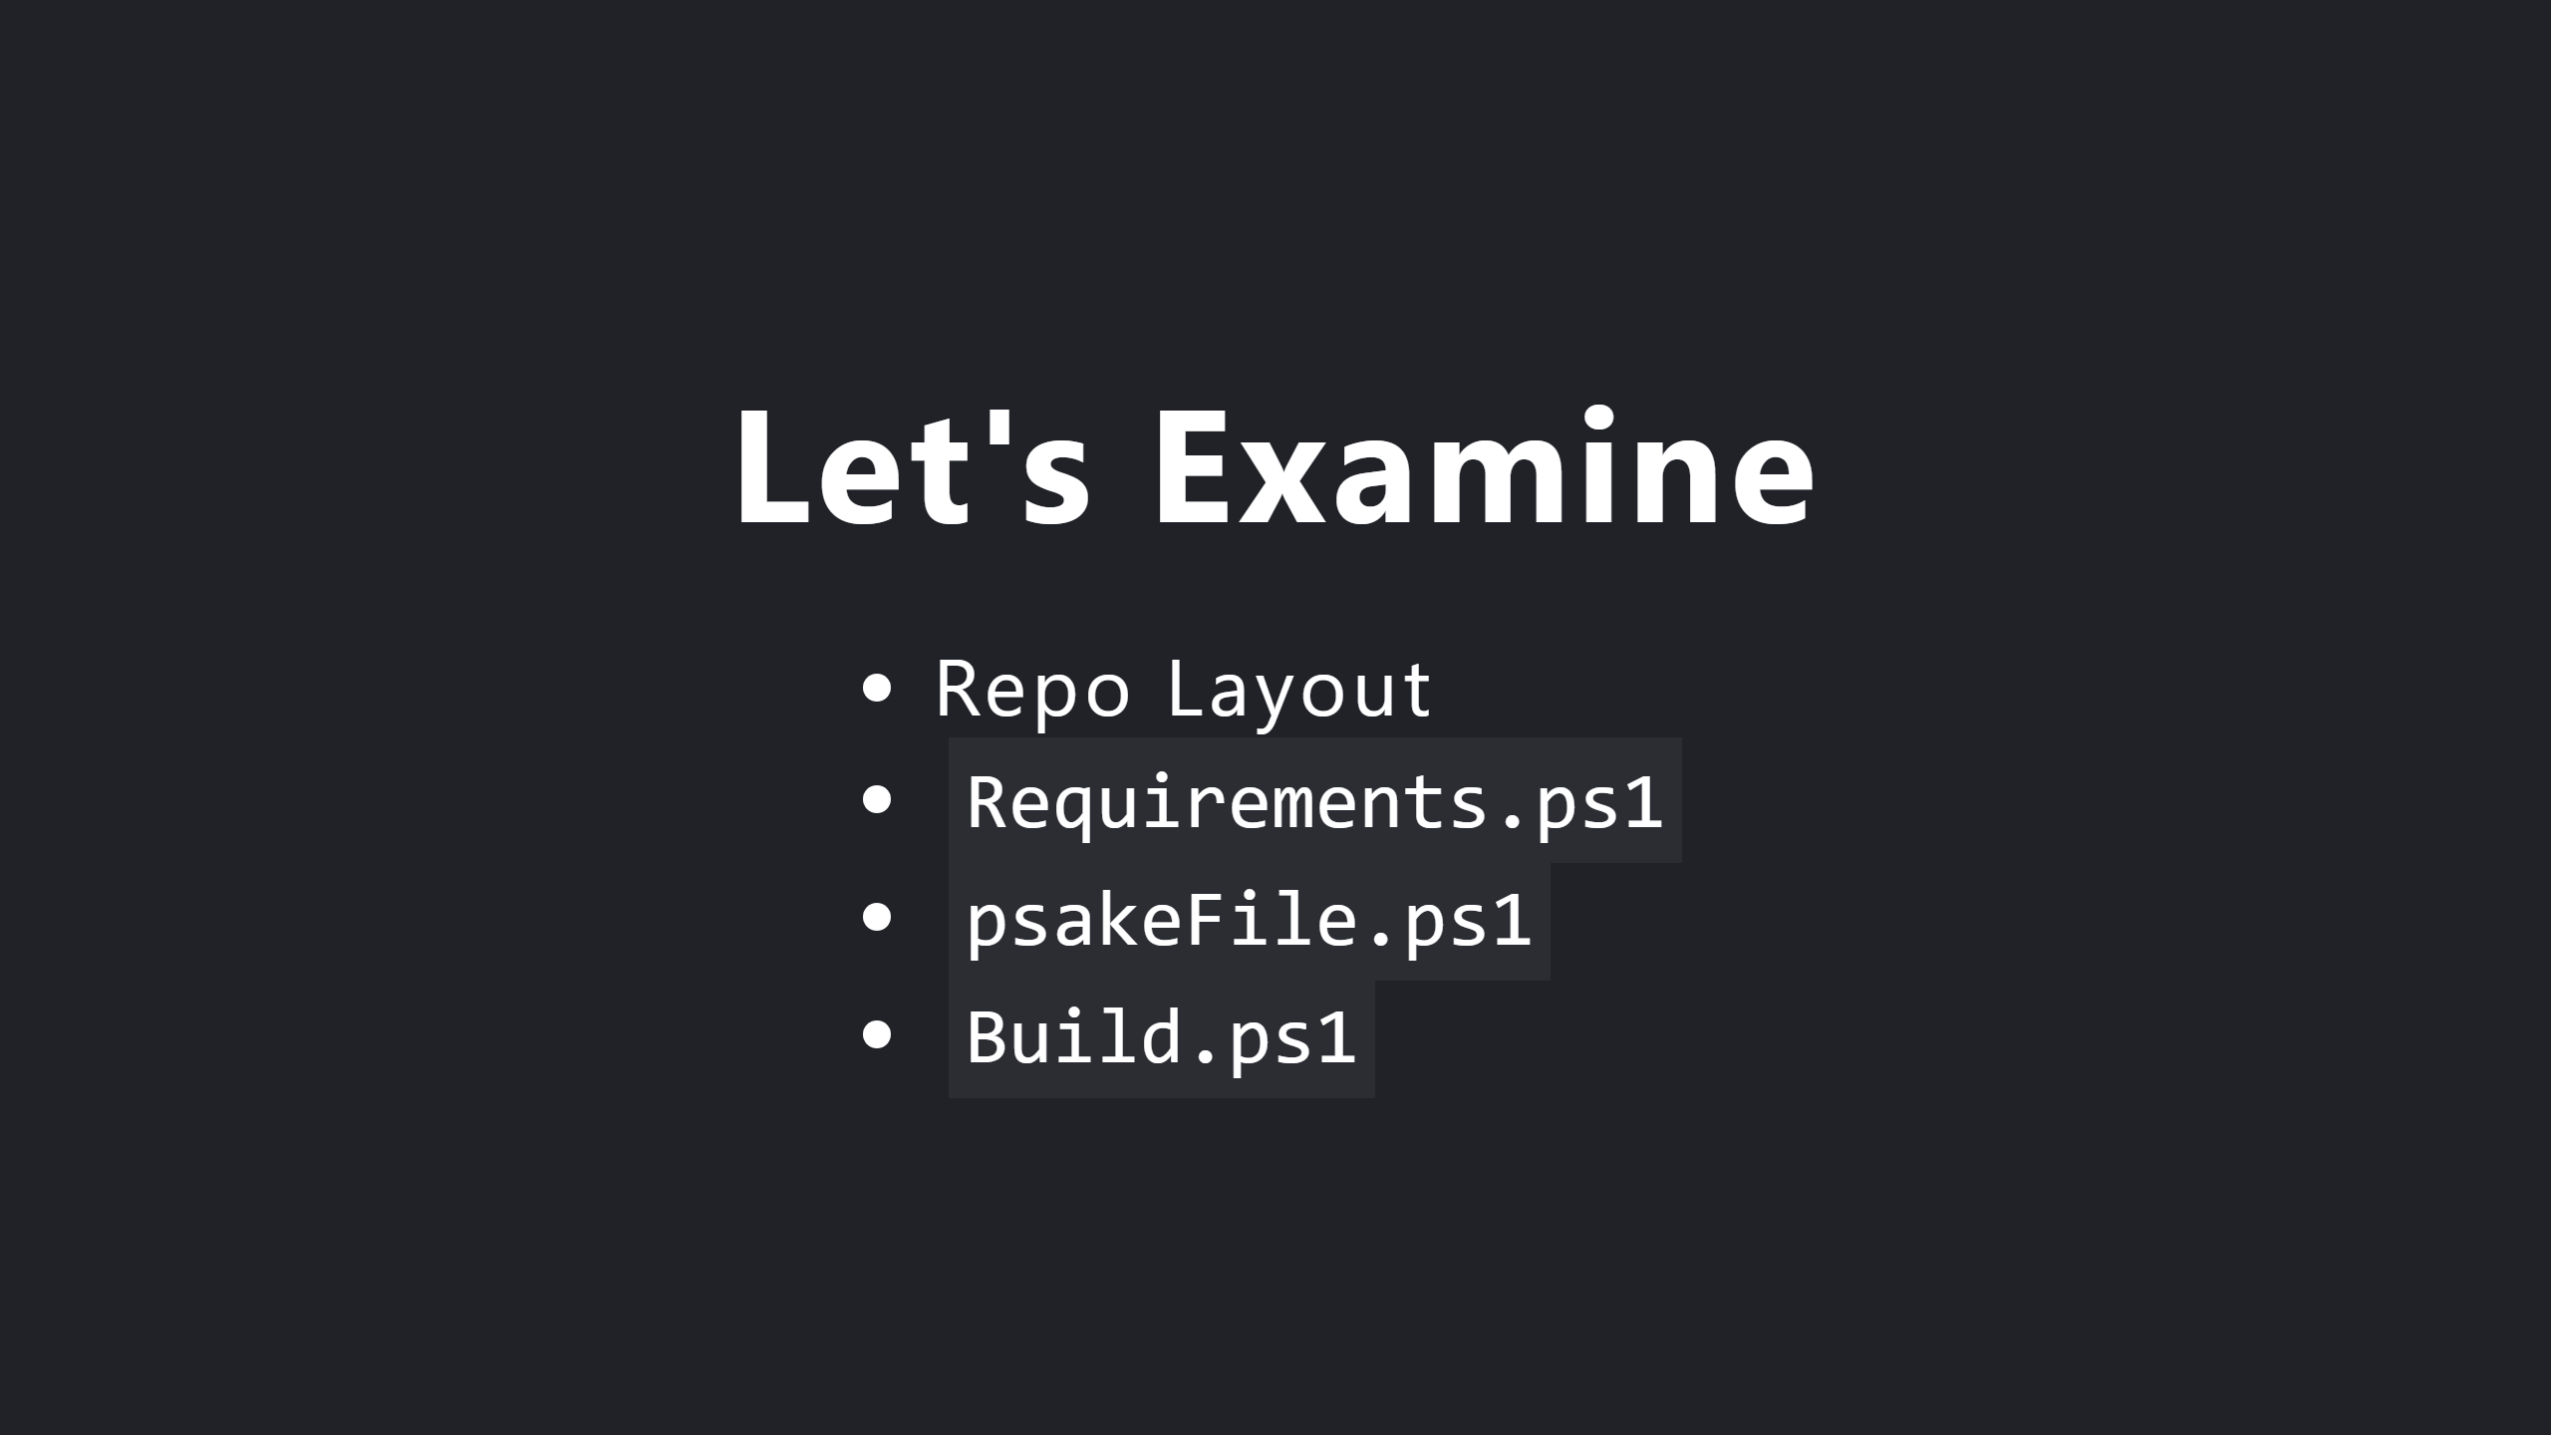

Slide 11
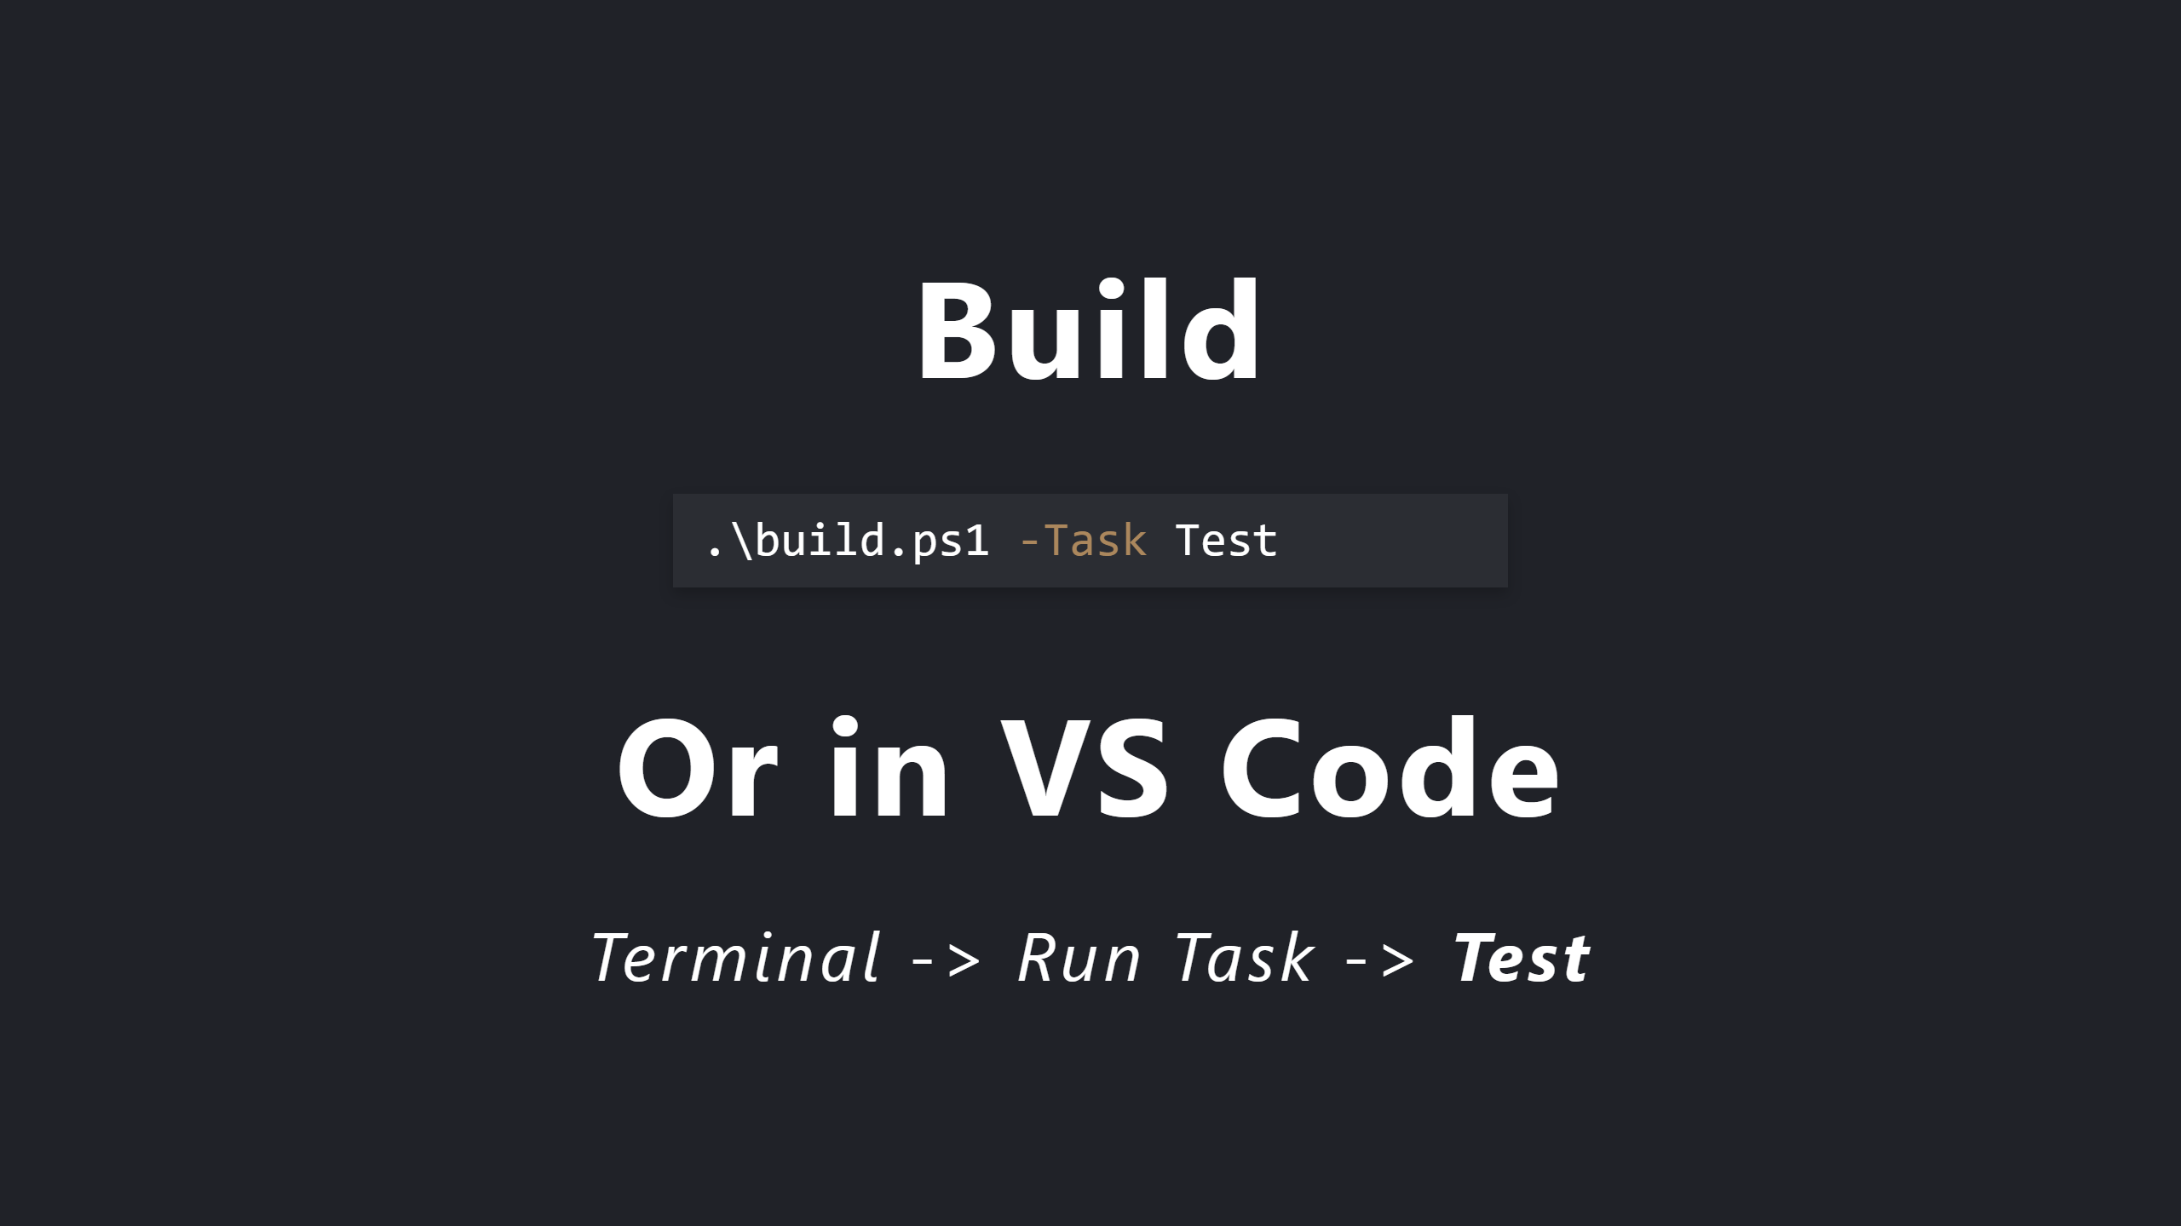
Notes:
Known issue with Windows PowerShell
https://github.com/psake/PowerShellBuild/pull/60

Slide 12
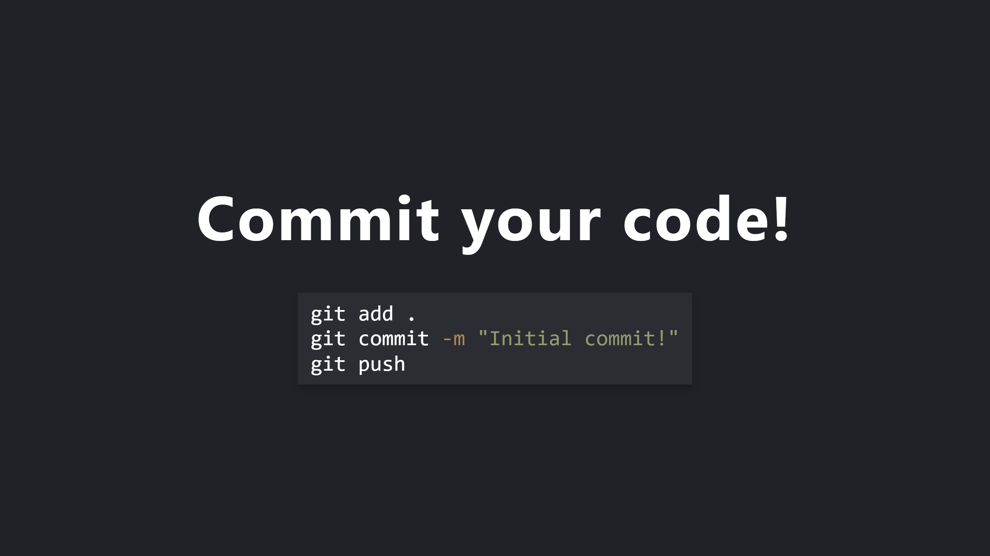

Slide 13
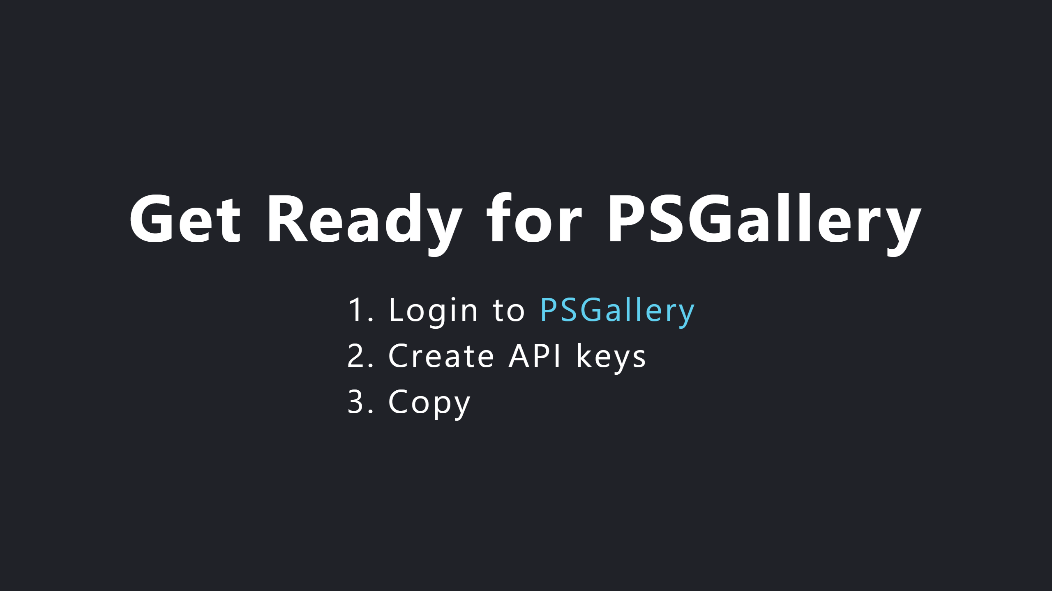

Slide 14
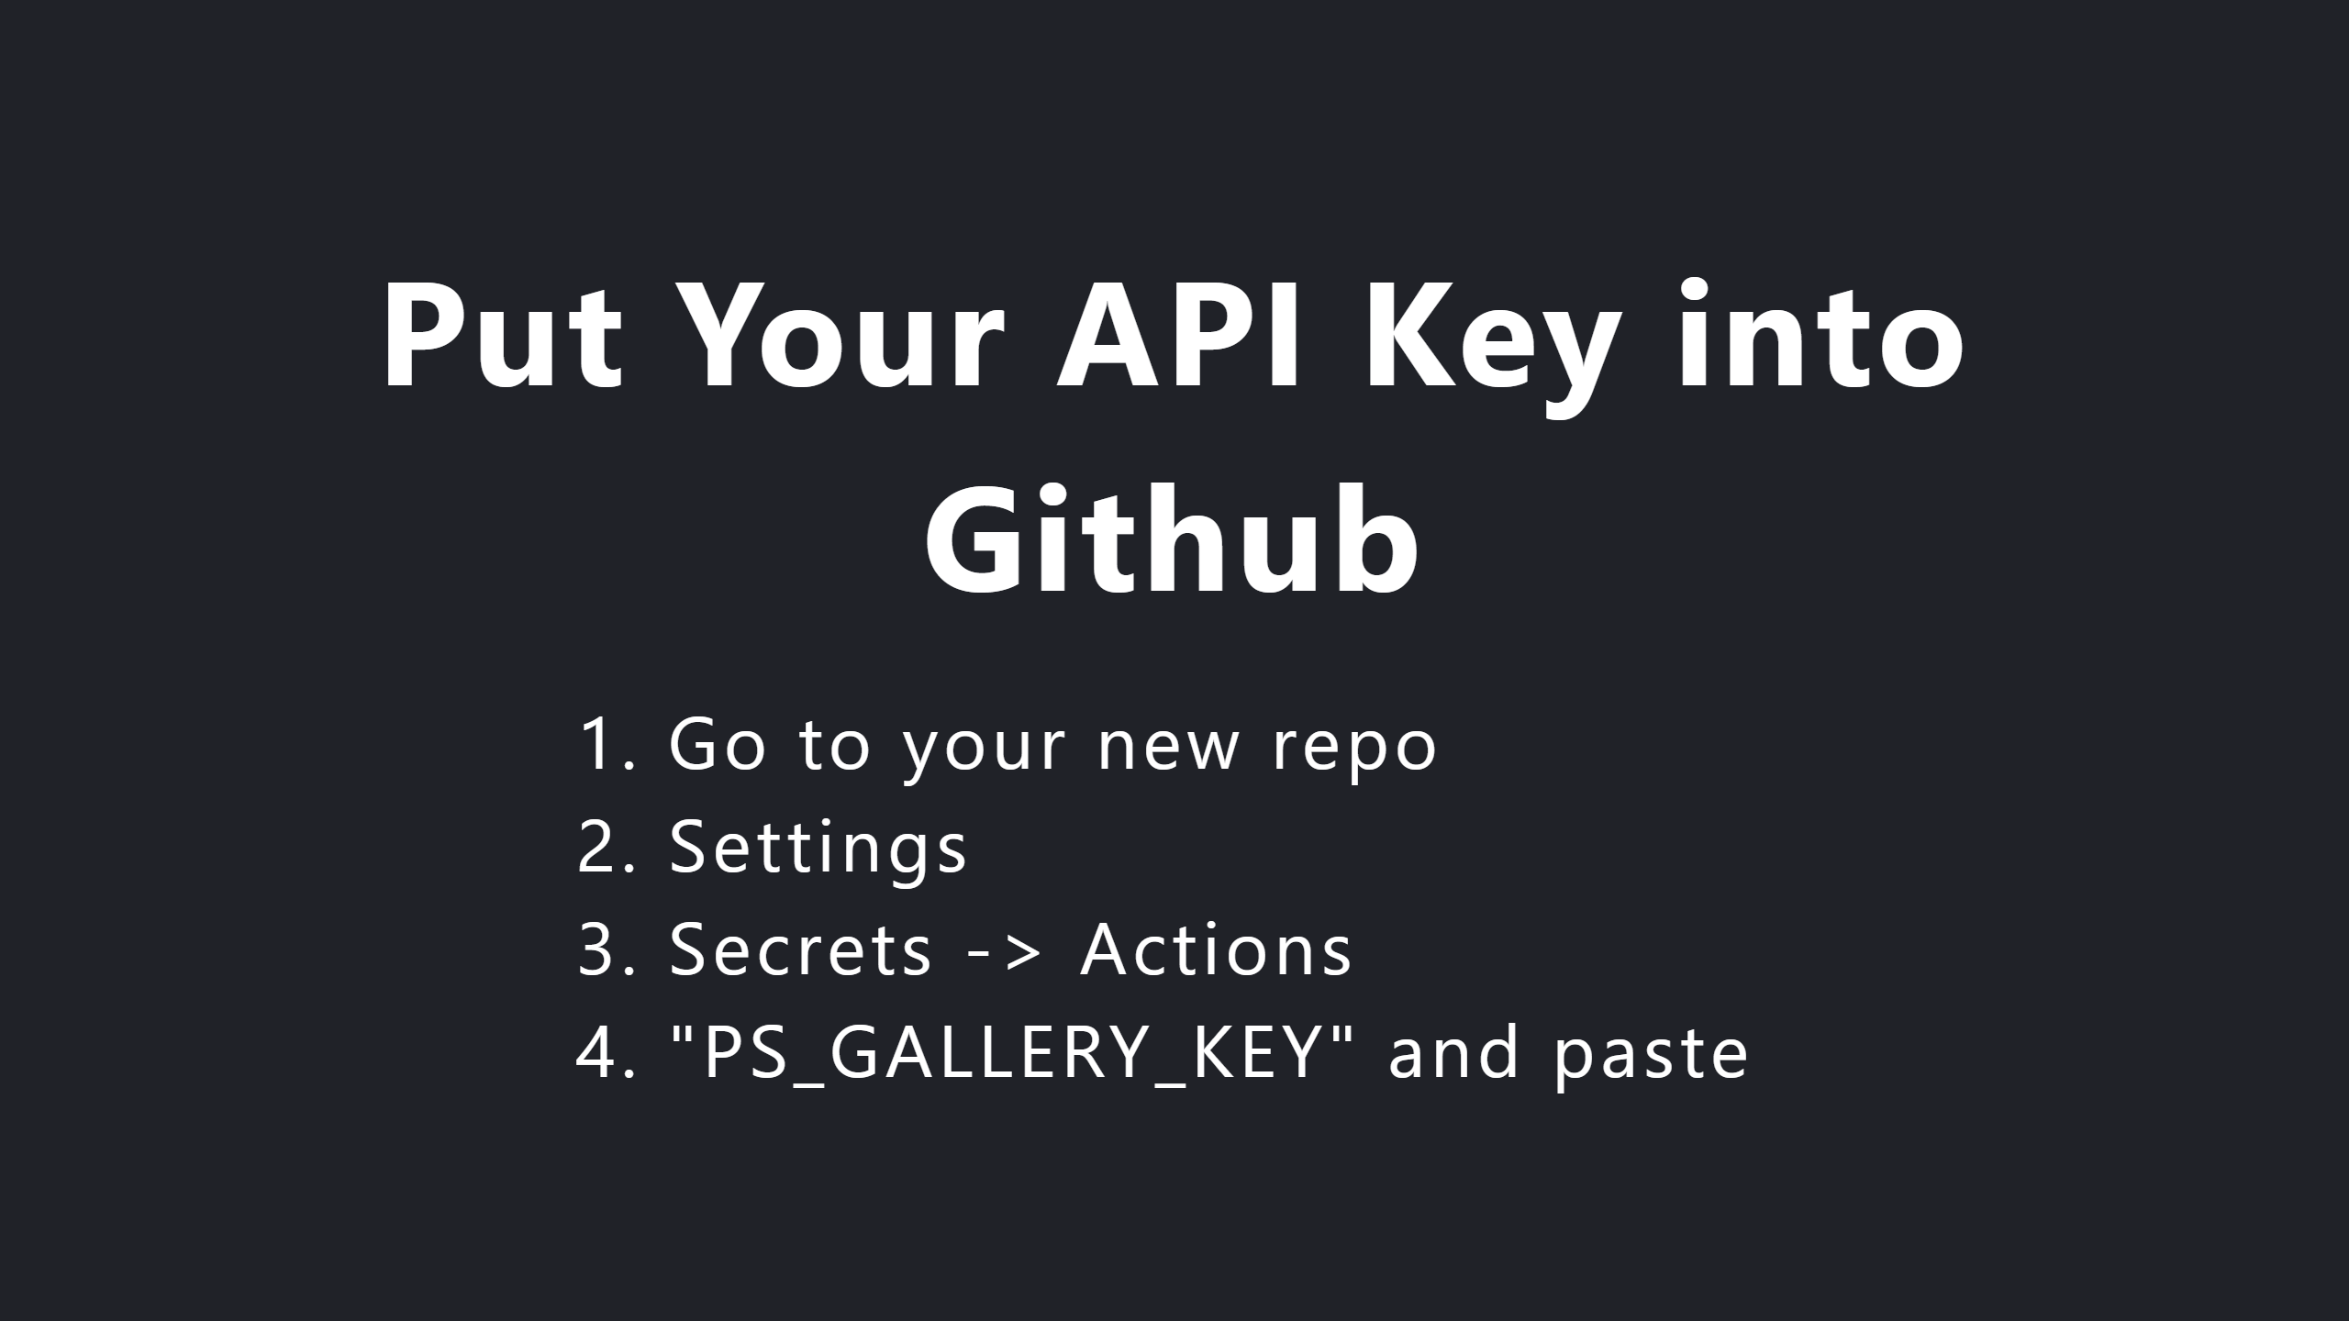
Notes:
Look into branch protection rules

Slide 15
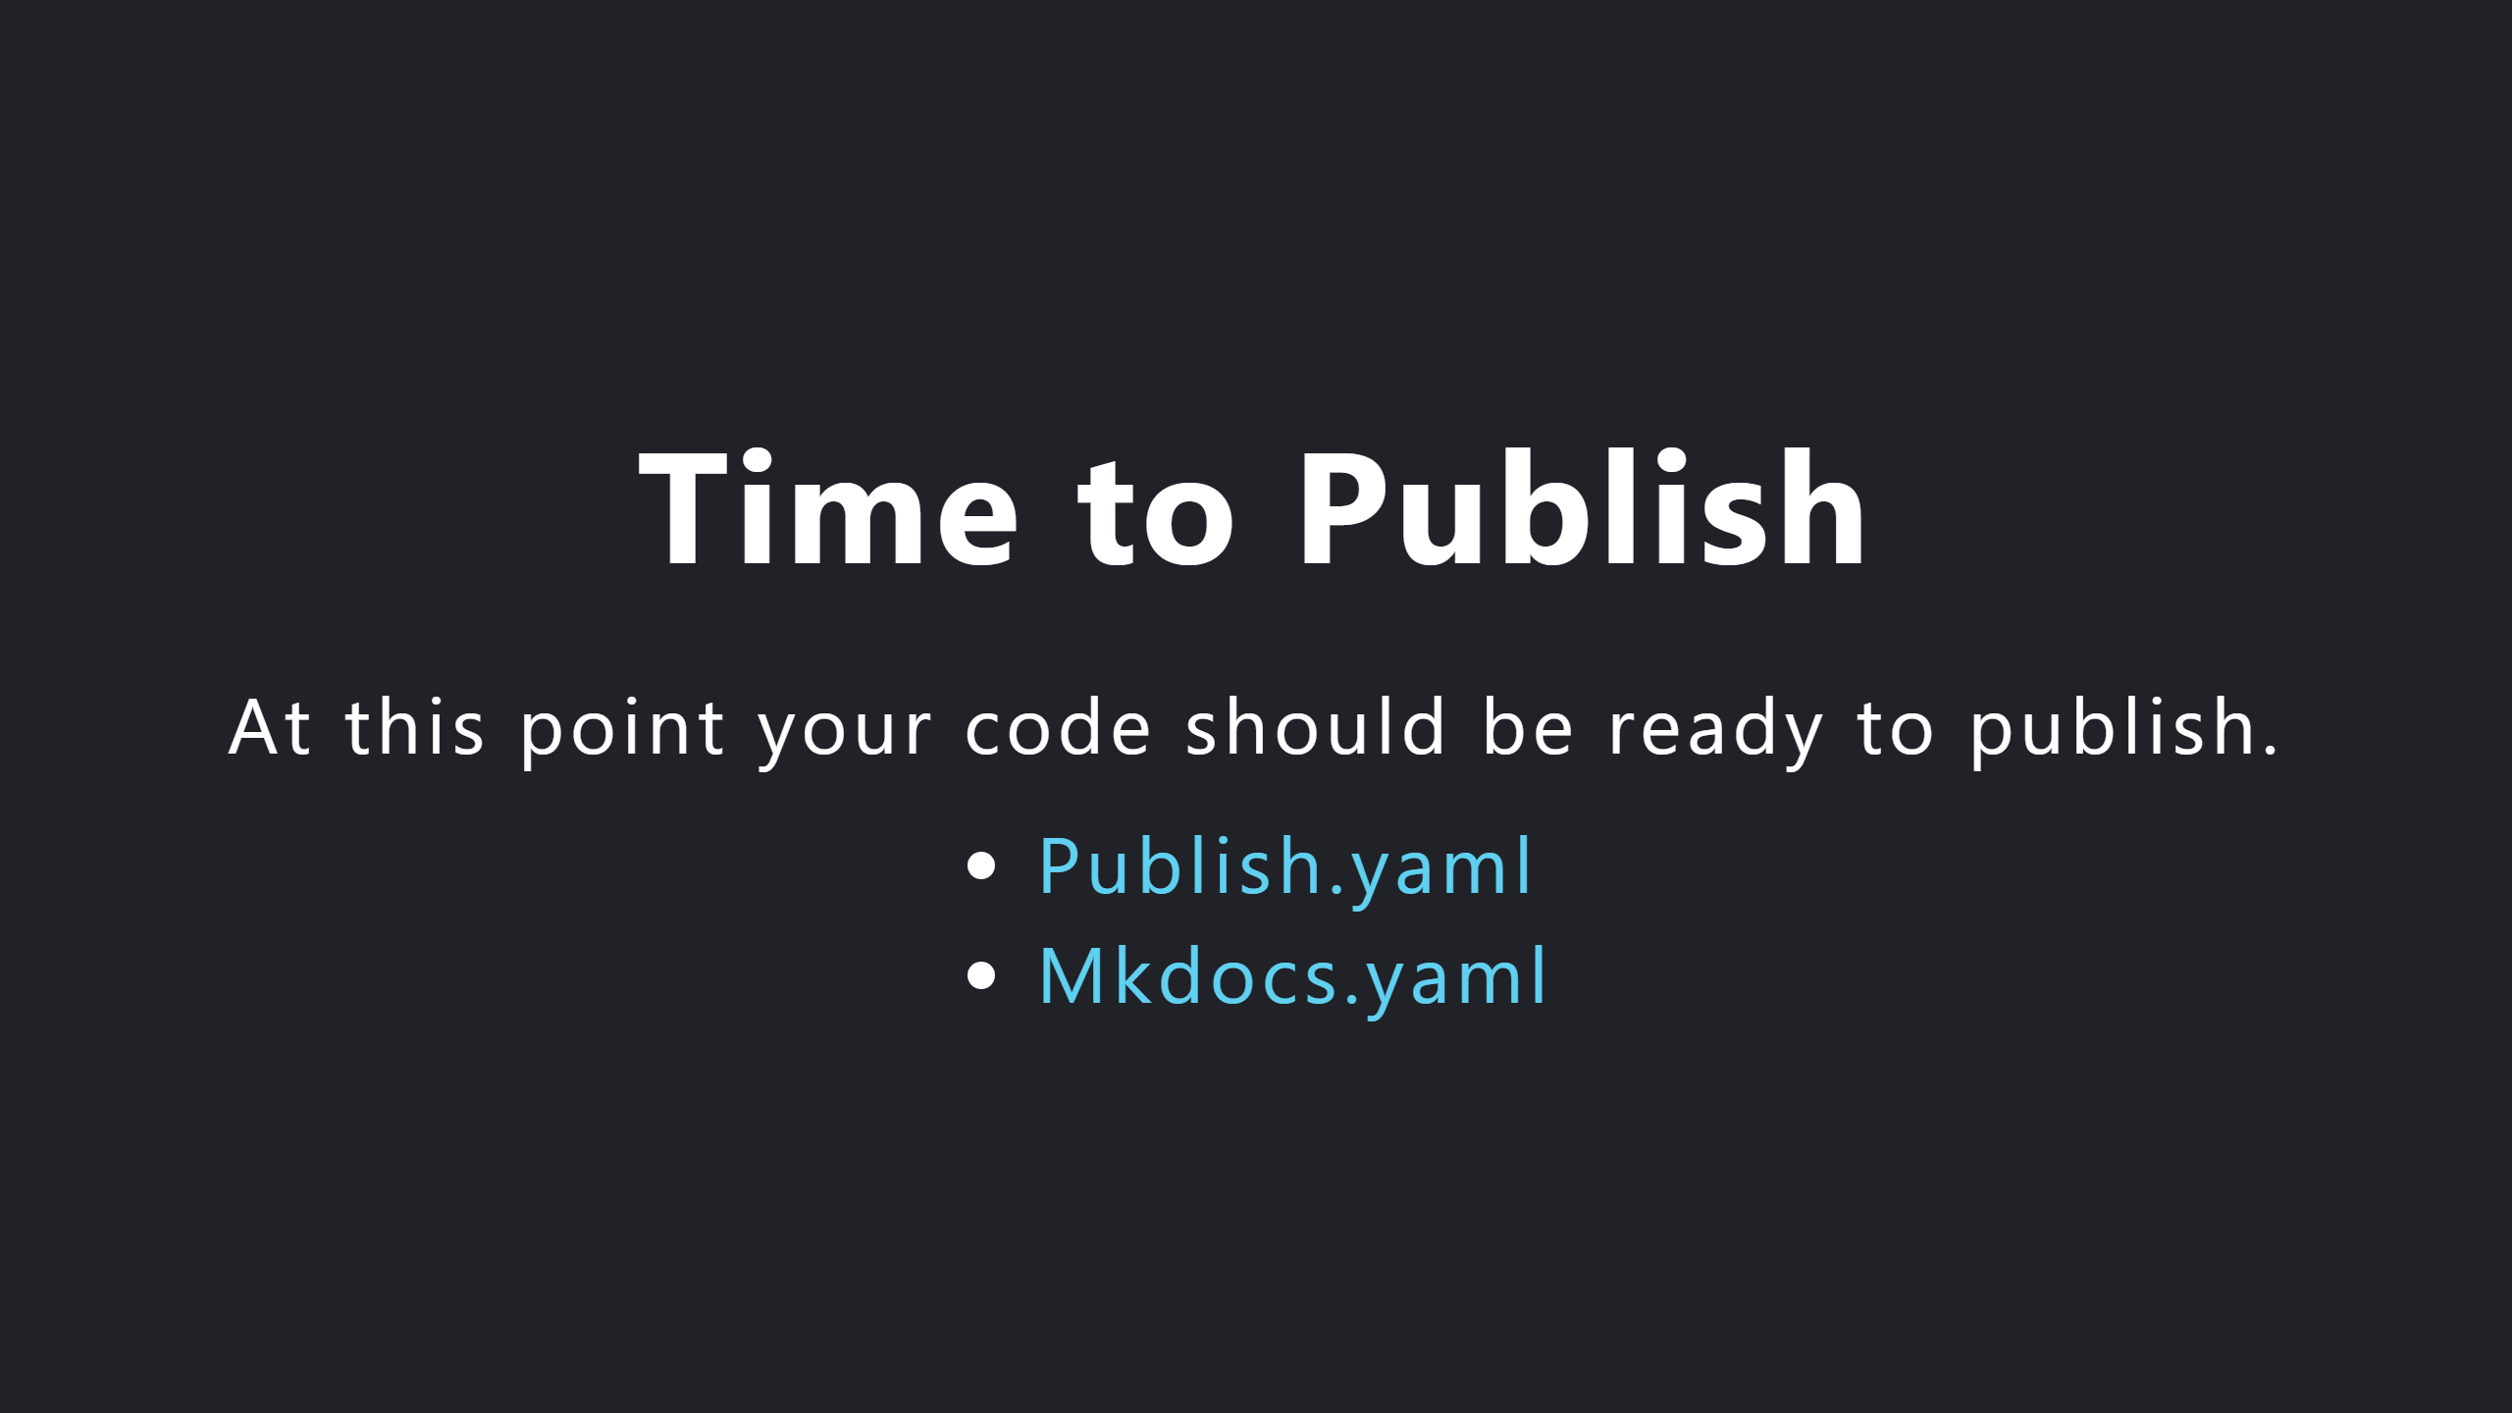

Slide 16
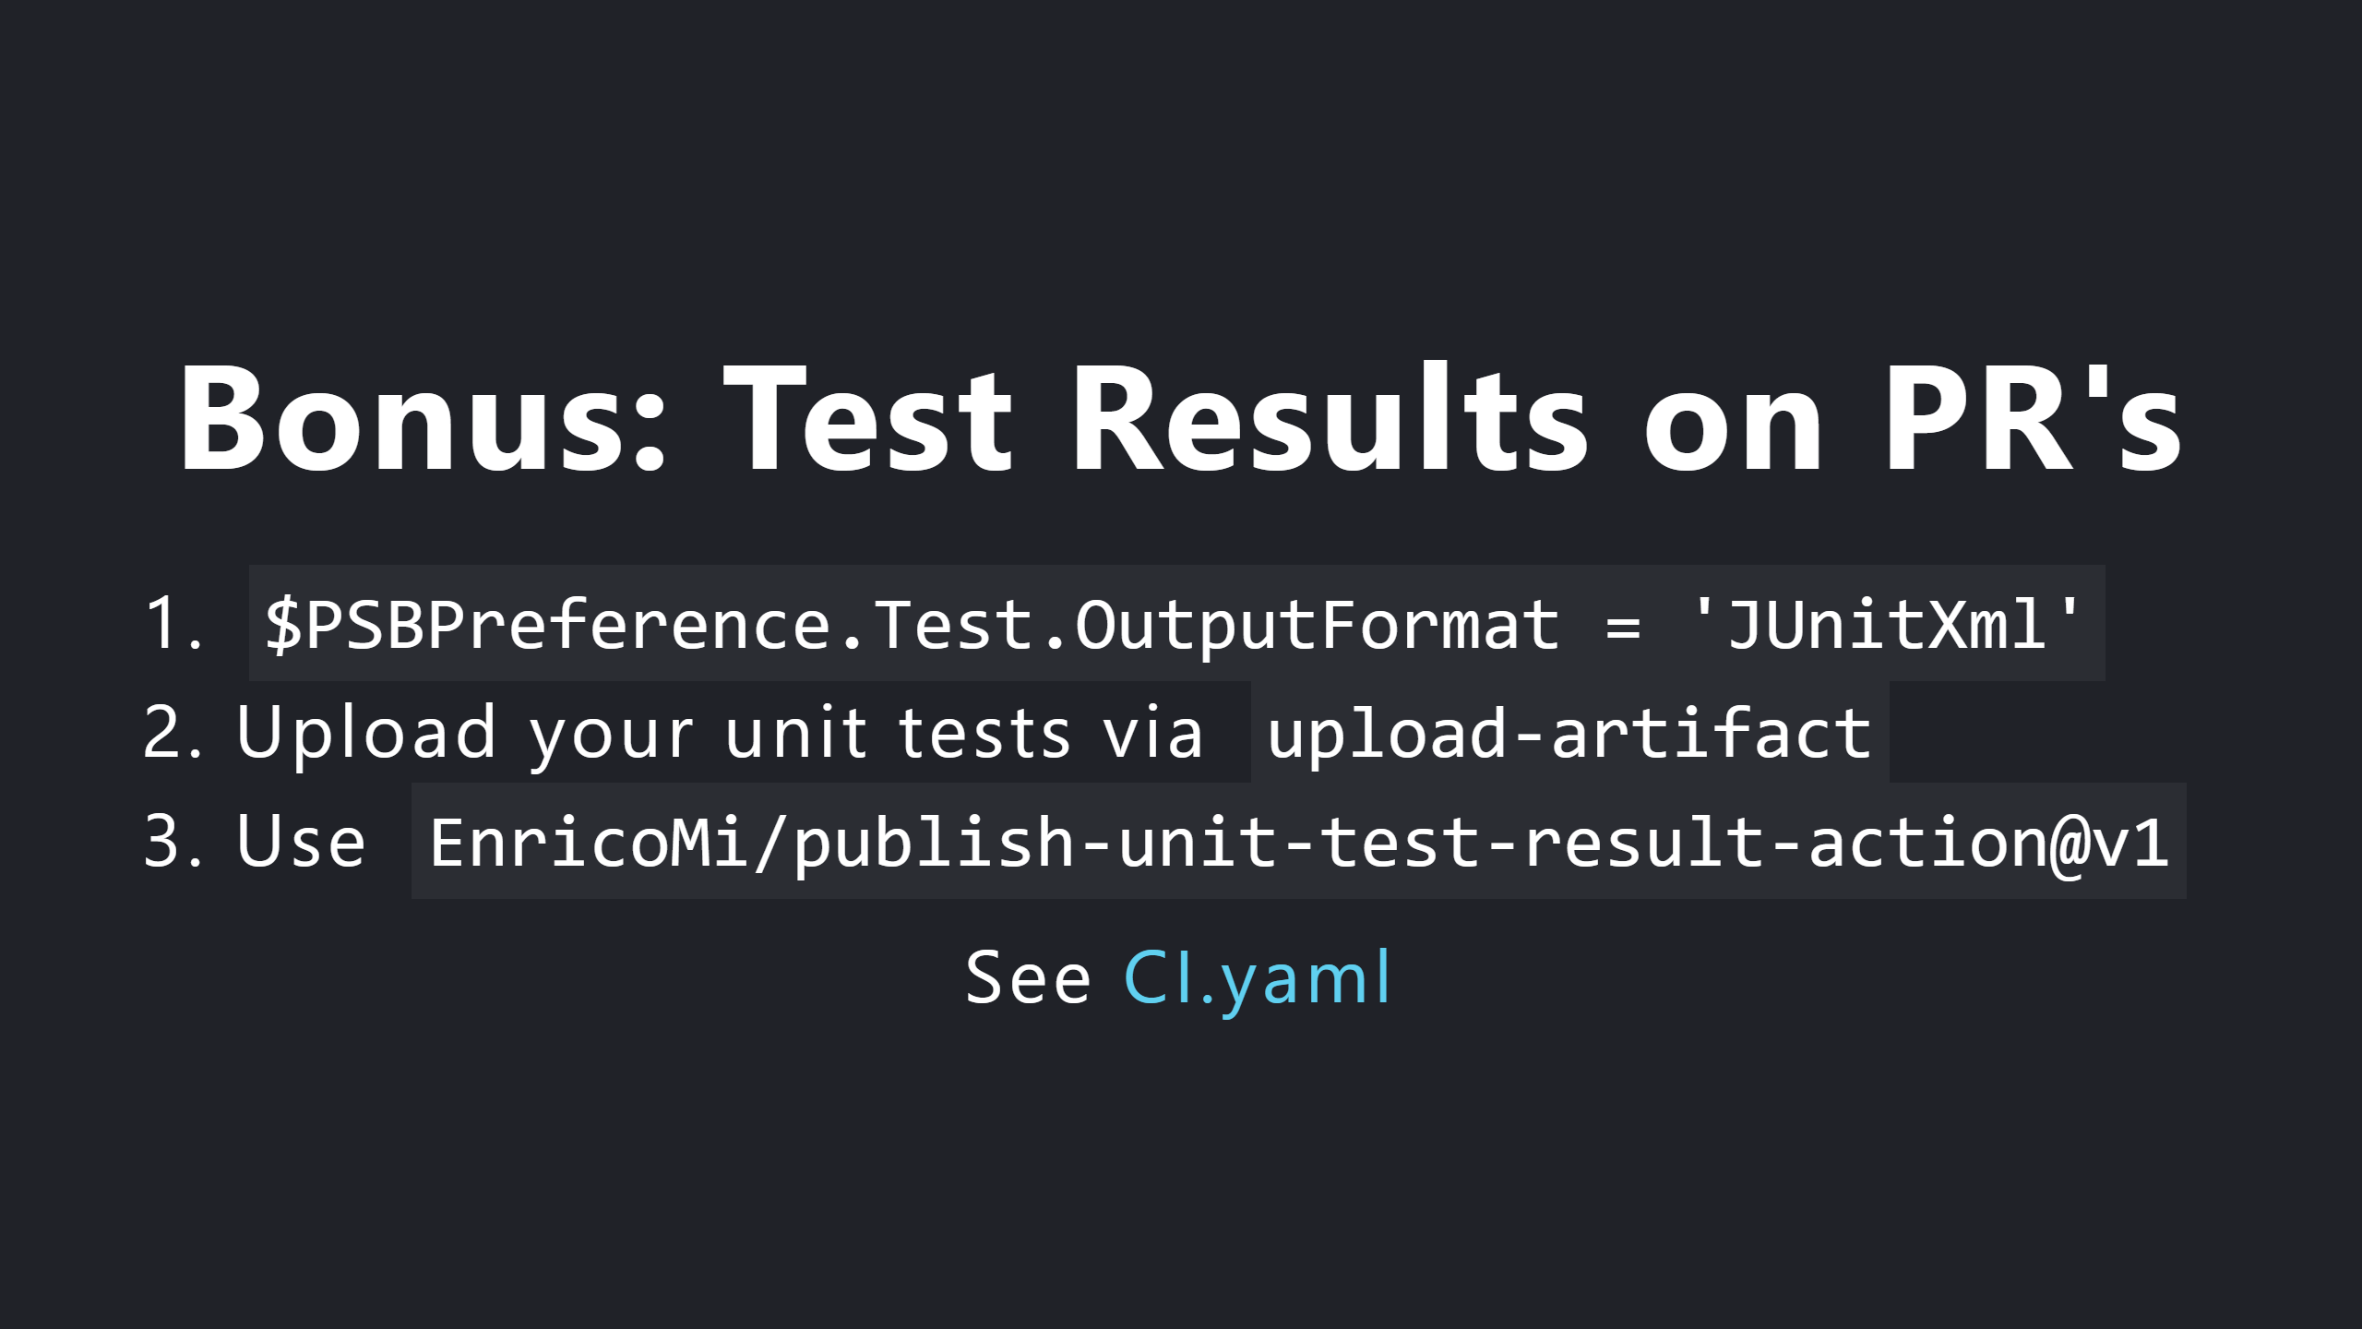

Slide 17


